Slide 1
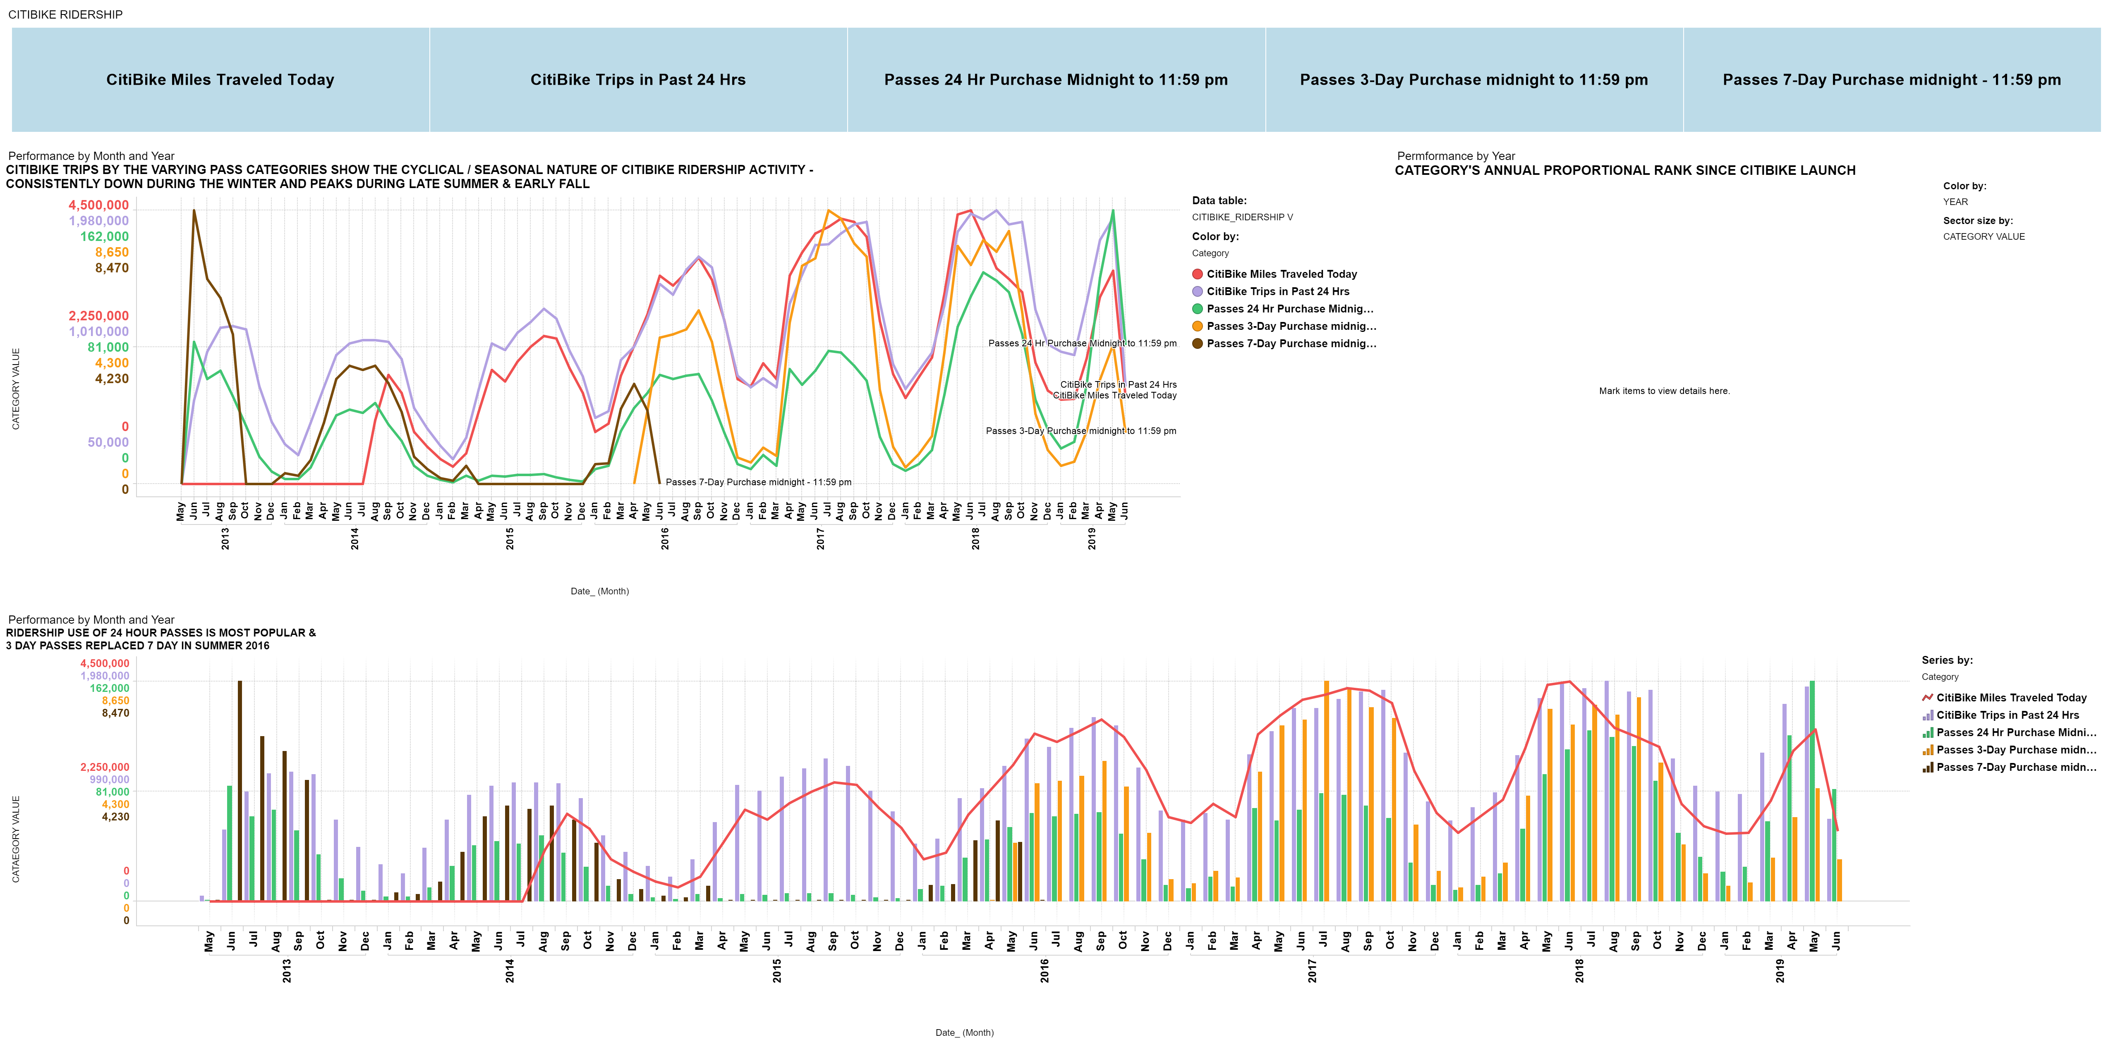
RIDERSHIP CATEGORY

Slide 2
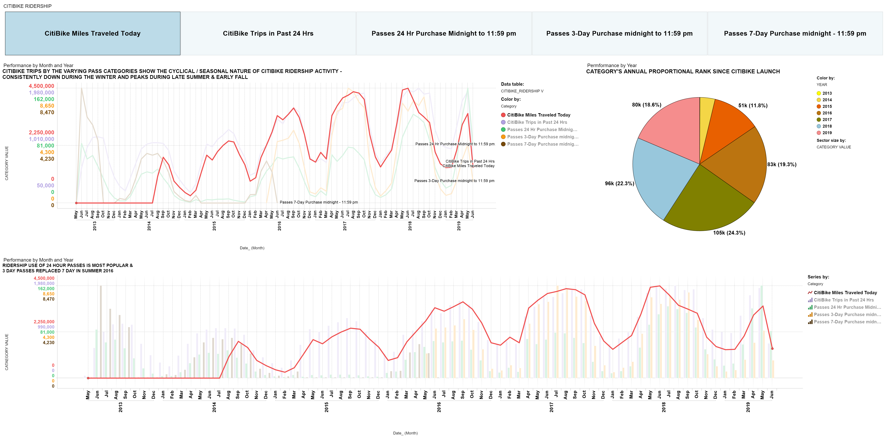
RIDERSHIP CATEGORY

Slide 3
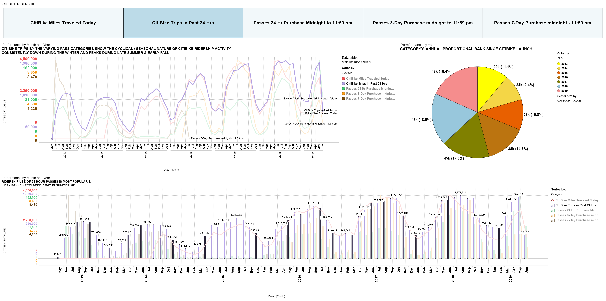
RIDERSHIP CATEGORY

Slide 4
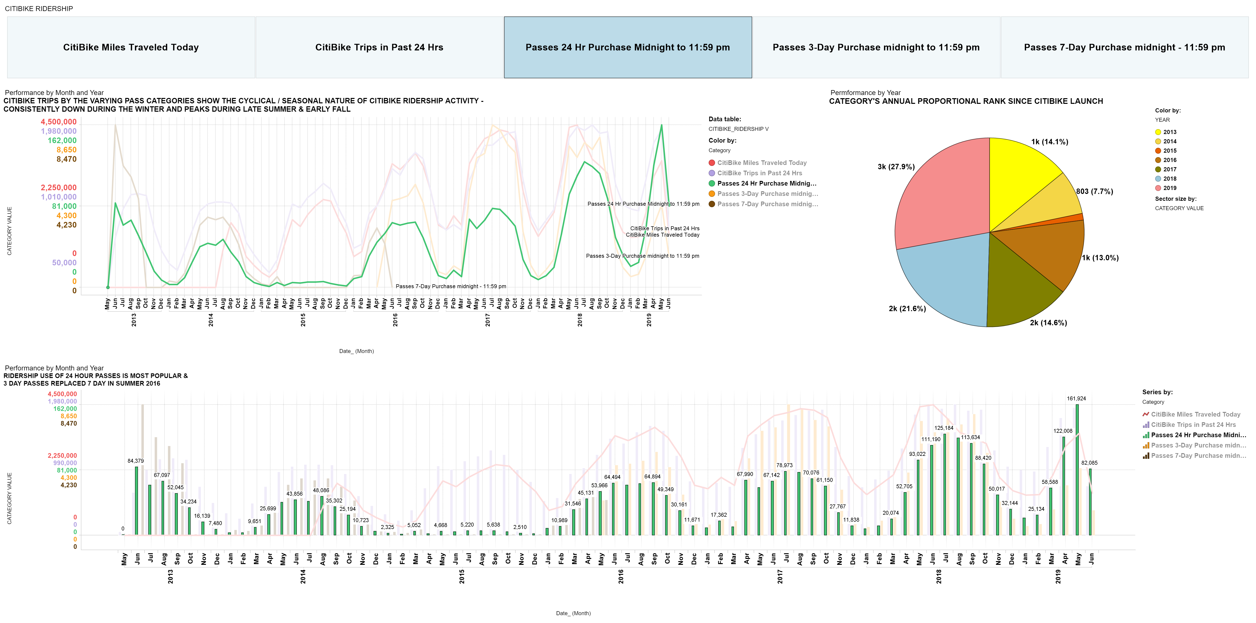
RIDERSHIP CATEGORY

Slide 5
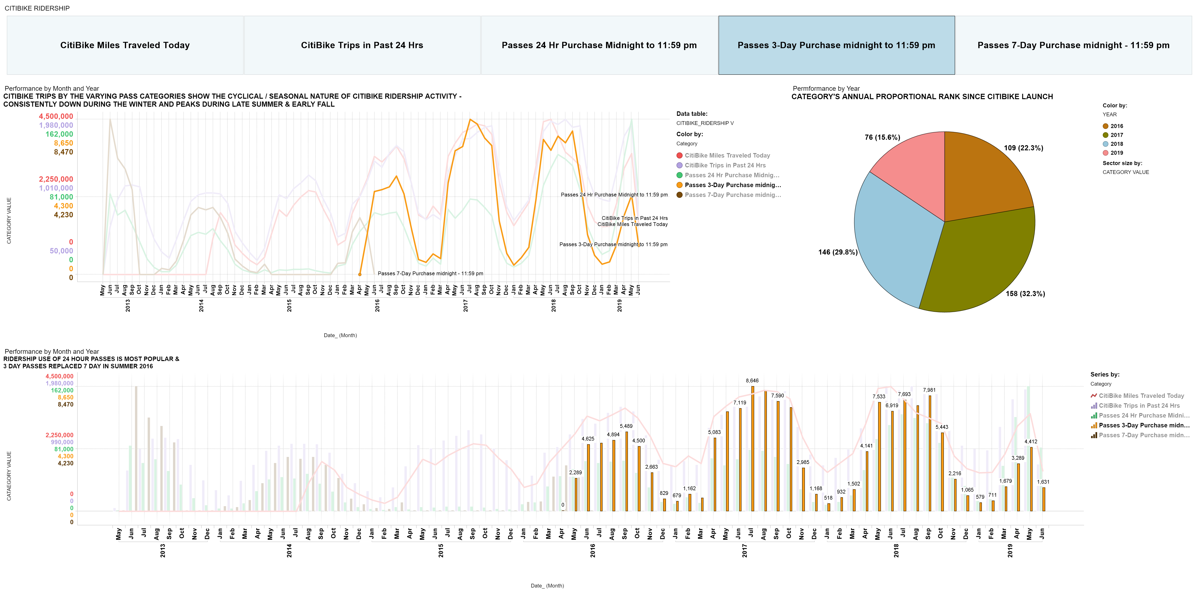
RIDERSHIP CATEGORY

Slide 6
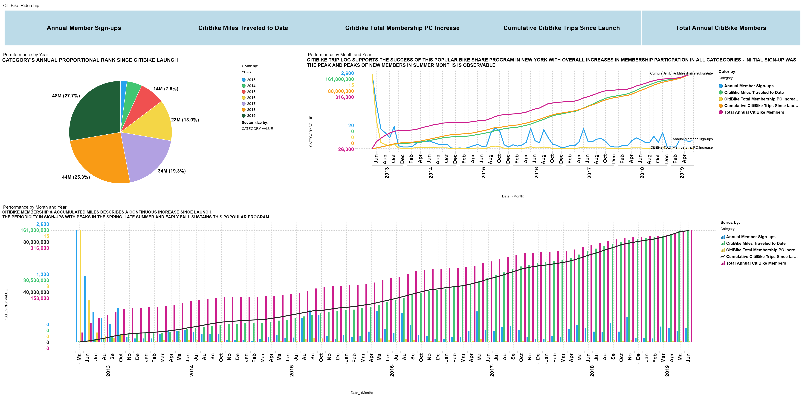
RIDERSHIP CATEGORY ANNUAL TOTALS

Slide 7
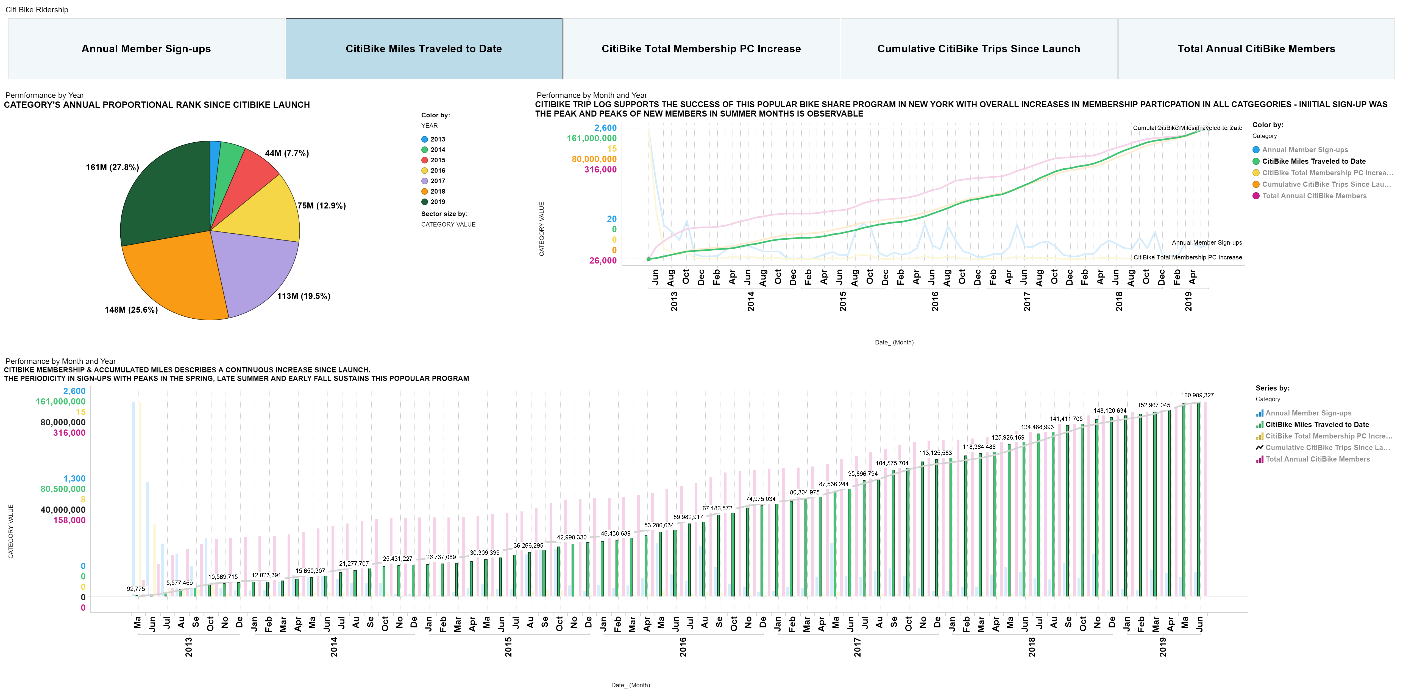
RIDERSHIP CATEGORY ANNUAL TOTALS

Slide 8
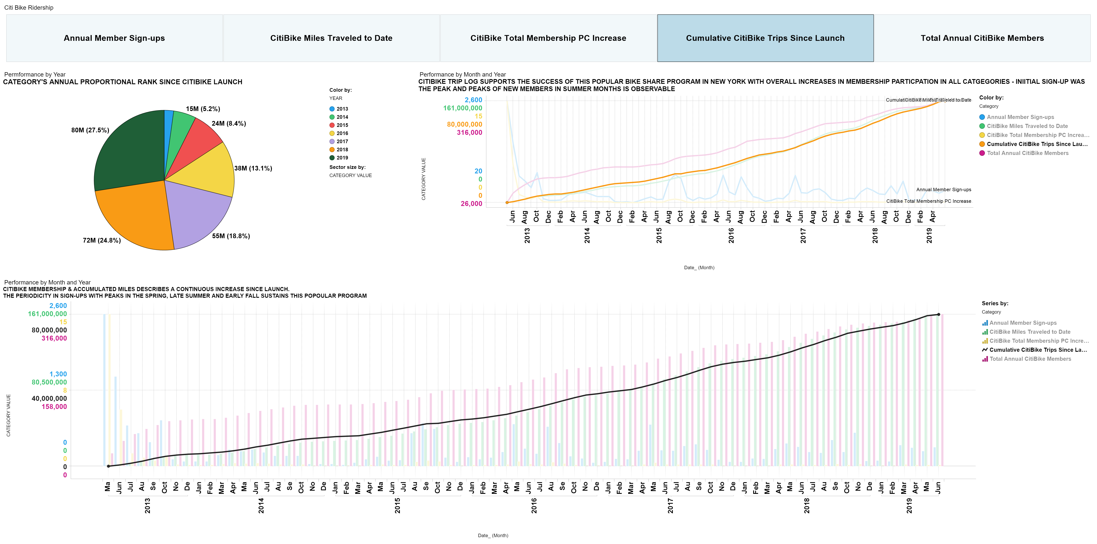
RIDERSHIP CATEGORY ANNUAL TOTALS

Slide 9
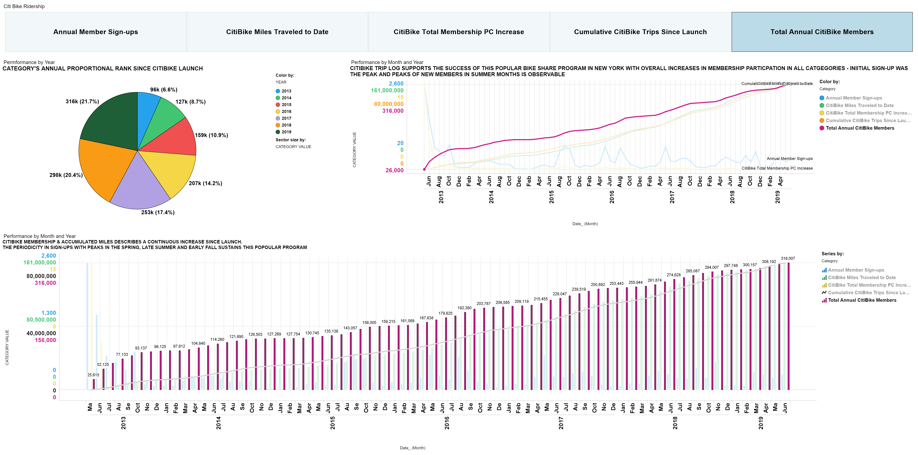
RIDERSHIP CATEGORY ANNUAL TOTALS

Slide 10
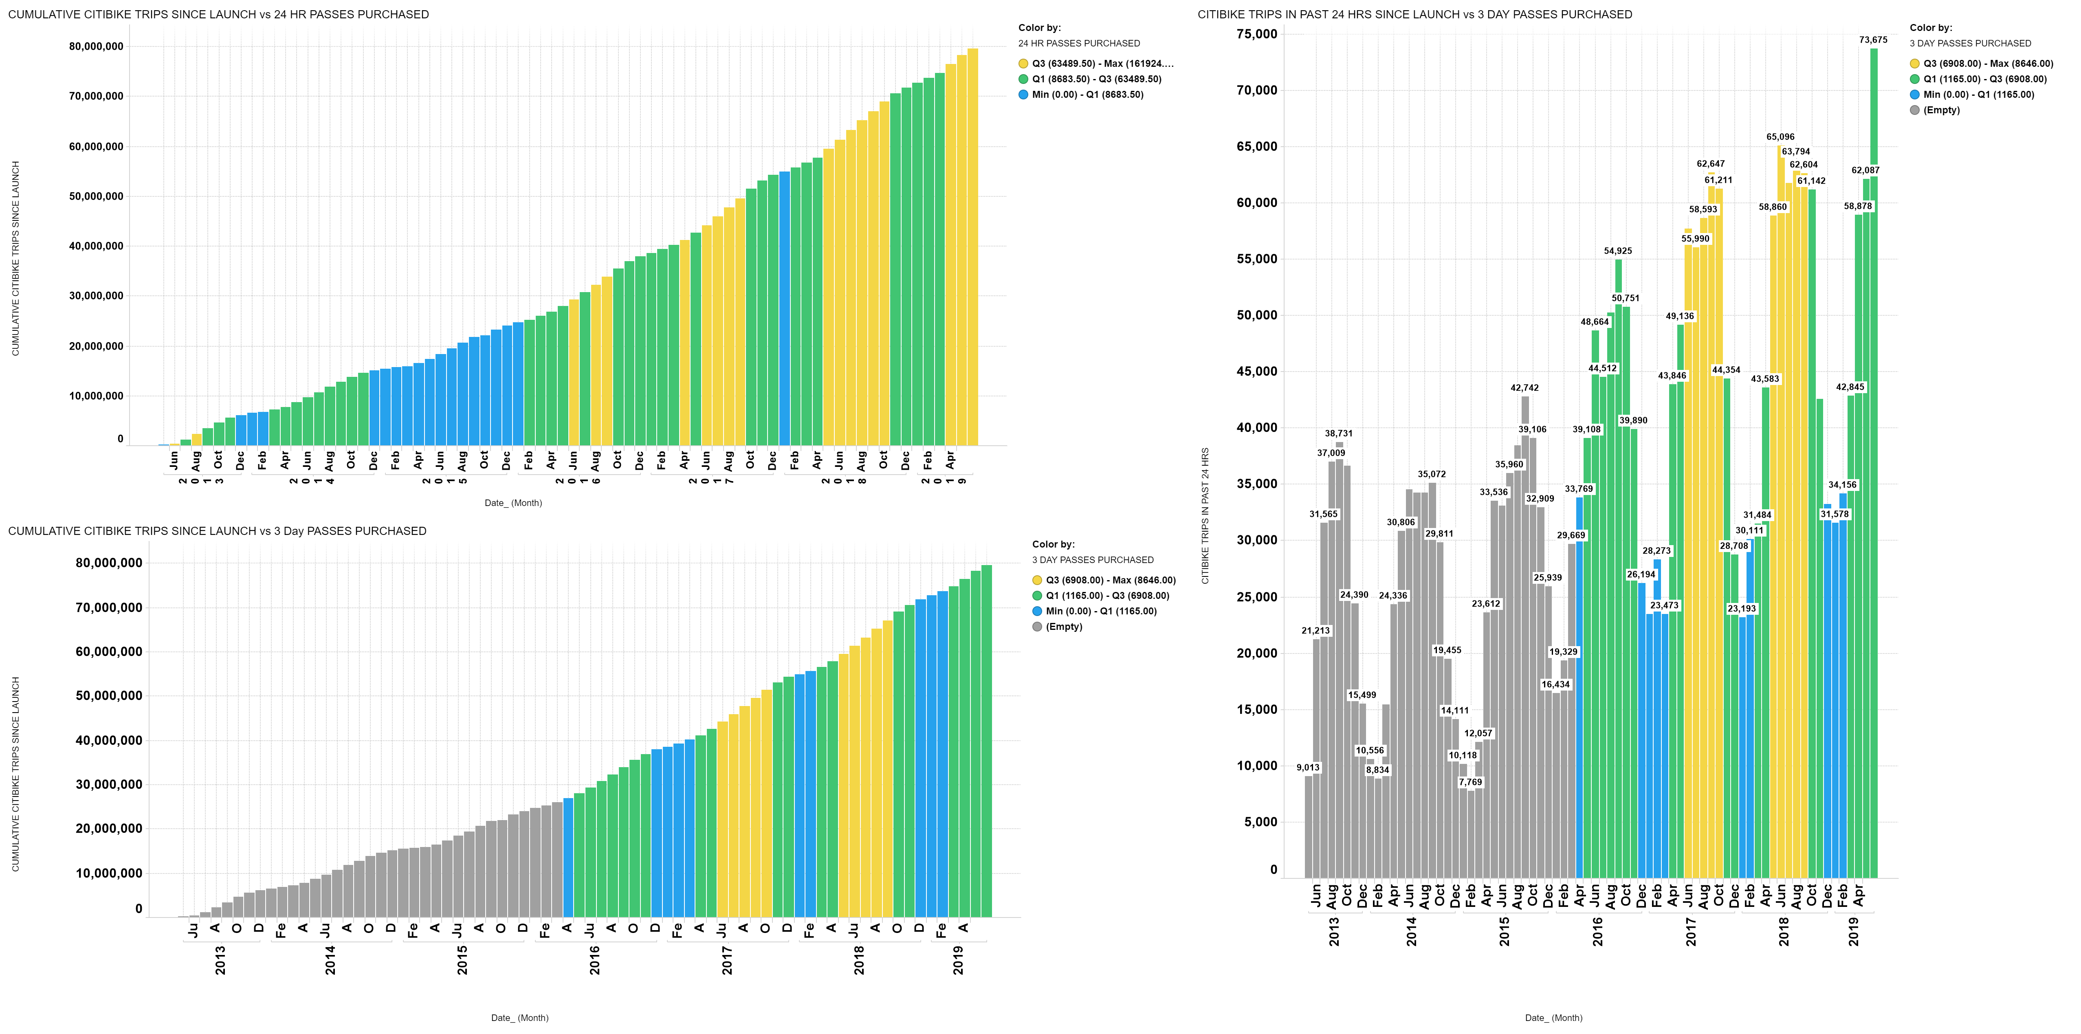
RIDERSHIP TRIPS by PASSES PURCHASED

Slide 11
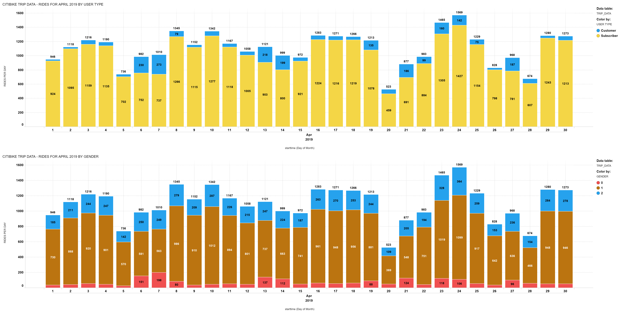
TRIP LOG APRIL 2019 BY USER TYPE AND GENDER

Slide 12
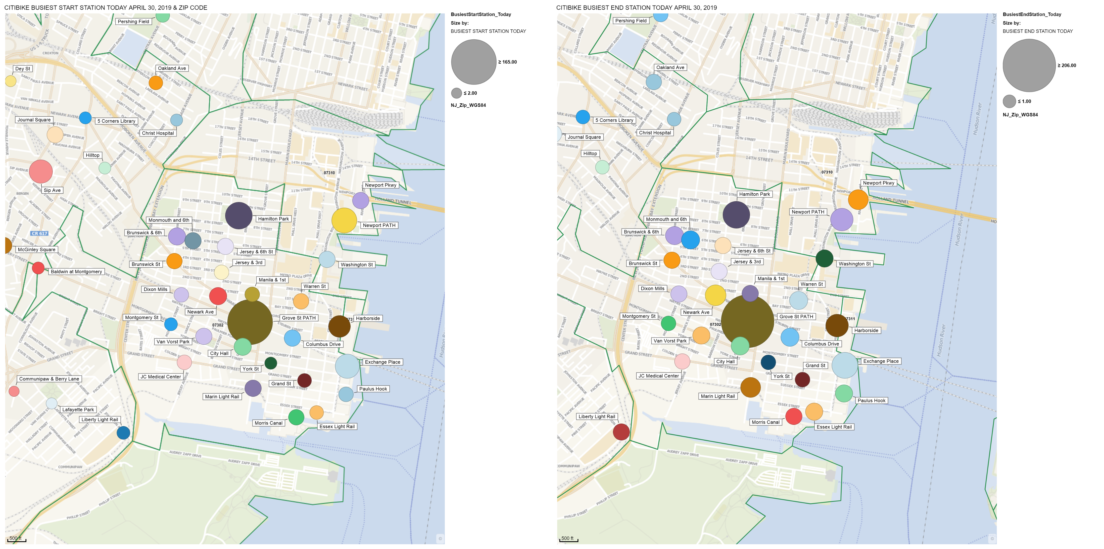
CITIBIKE STATION MAP - TRIP DATA TODAY

Slide 13
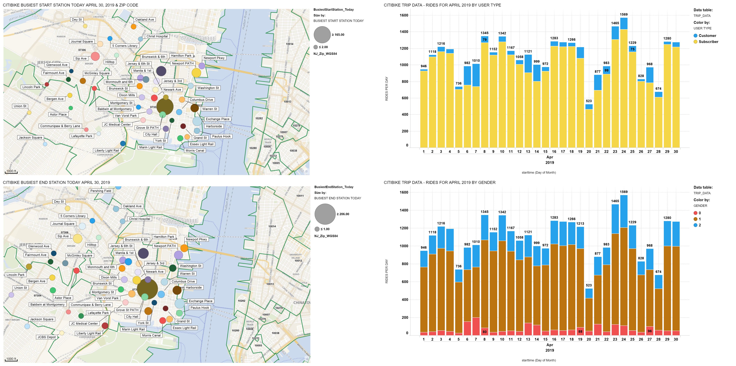
CITIBIKE STATION MAP - TRIP DATA TODAY

Slide 14
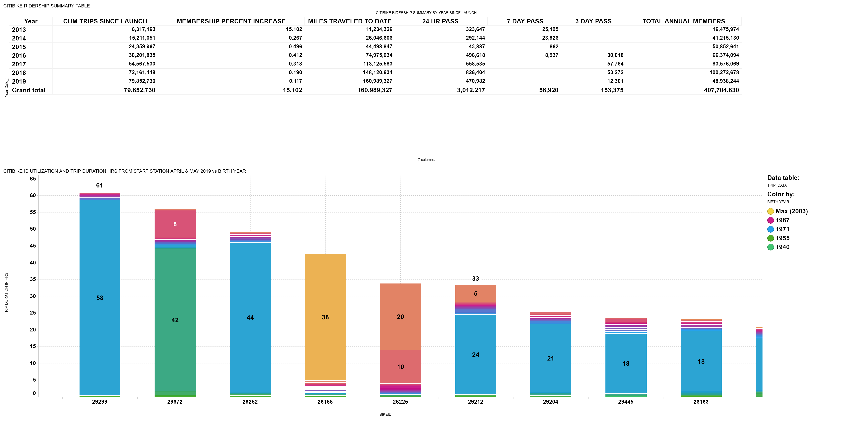
SUMMARY: RIDERSHIP - BIKEID vs AGE

